Slide 1
PHOTO EDITING - Technical Design
CSE 611 – MS Project Development
Professor – Jinjun Xiong

Slide 2
TEAM MEMBERS
Pavana Lakshmi Venugopal
Saad Ahmed
Taraka Rohit Adusumilli
Ayesha Humaera

Slide 3
Tech Stack
Front End:
Back End:
Stack | Functionality
React Js | Create UI Interface
HTML & CSS | Build UI framework and Styling
JavaScript | Dynamic content update
Stack | Functionality
Python | Develop backend
Django REST API | Create and manage REST APIs
‹#›

Slide 4
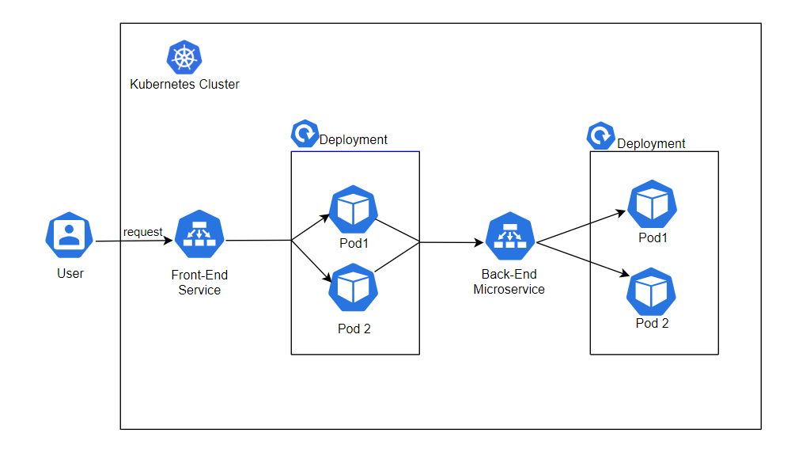
Deployment
‹#›

Slide 5
Deployment Structure
Backend Deployment: contains Django application, which serves as the backend of the application
Frontend Deployment: contains React application. It's responsible for rendering the user interface, handling user interactions, and making API requests to the backend.
Advantages
Scalability- scale backend/frontend based on requirement
Isolation -Easier to manage and update components independently

Slide 6
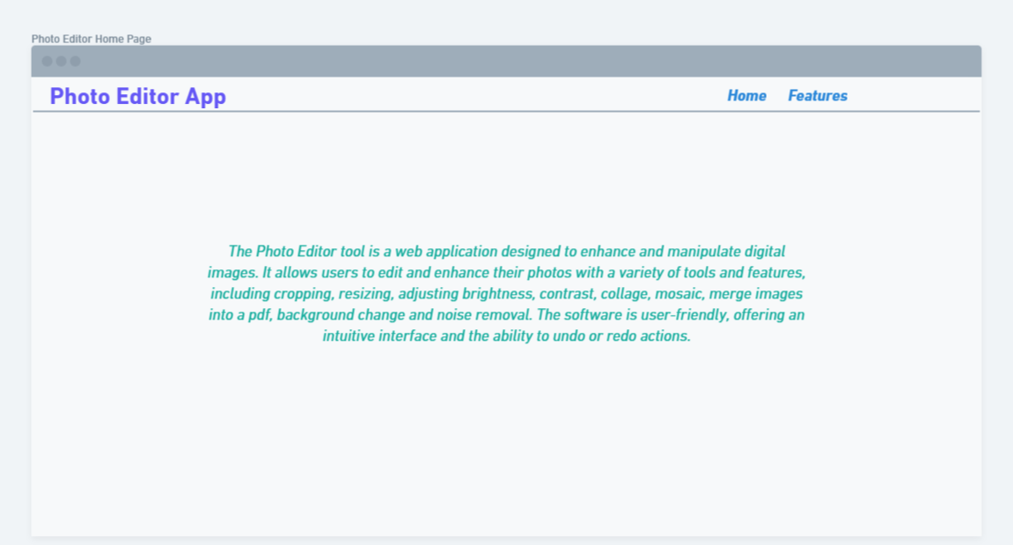
Wireframe Home Page
‹#›

Slide 7
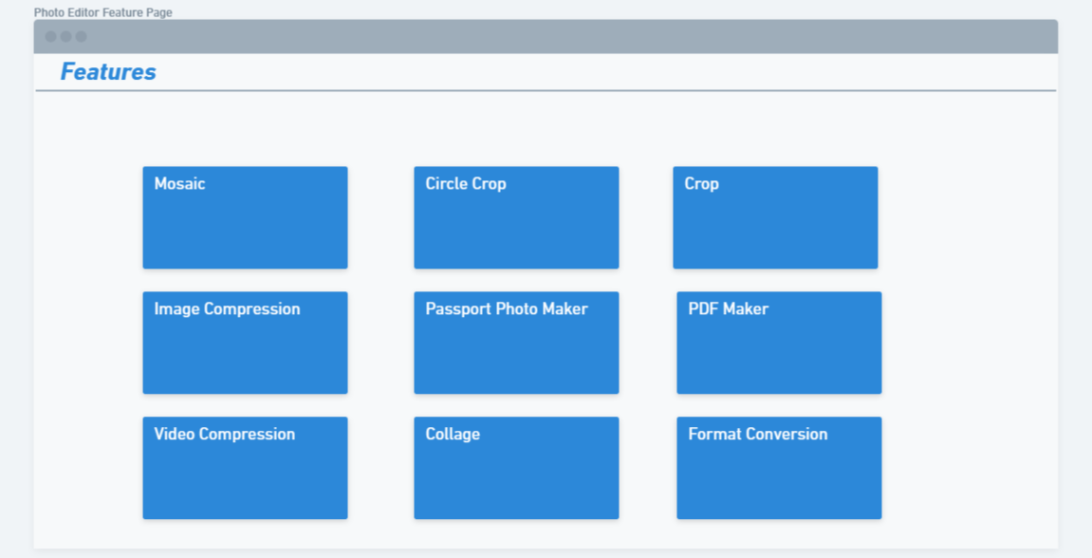
Wireframe Features
‹#›

Slide 8
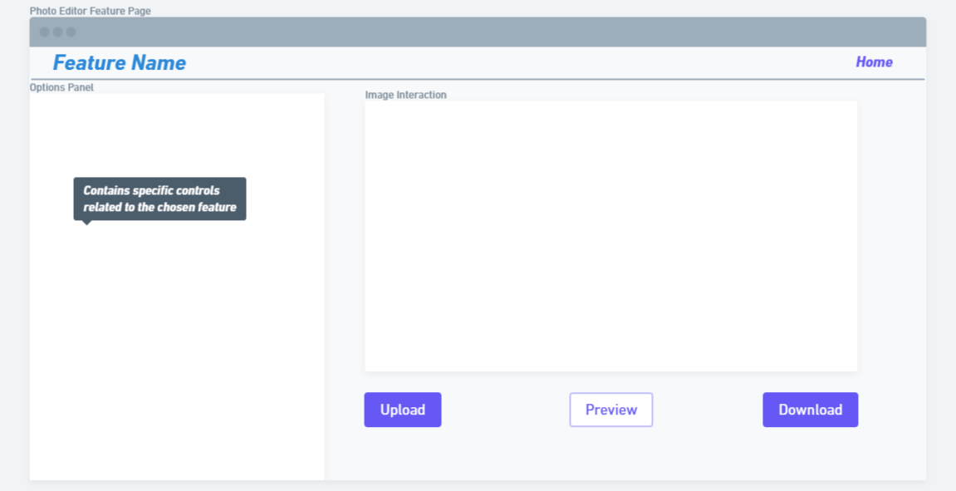
Wireframe Feature Screen
‹#›

Slide 9
Wireframe Review & Direction
Wireframe Overview
Presents a skeletal visualization of our User Interface (UI).
Previously shown wireframes showcase the layout for both the home page and feature pages of our Photo Editor.
Main Page Highlights
a. Feature Cards
Multiple cards detailing each feature.
Each card is accompanied by a concise explanation of its functionality.
b. Navigation & Flow
Clicking on any feature card leads to its respective feature page.
Intuitive layout ensures easy user navigation.
Notes:
‹#›

Slide 10
Wireframe Review & Direction
Feature Page Layout
a. Options Panel
Positioned to the left.
Contains specific controls related to the chosen feature.
b. Image Interaction
Located to the right.
Allows users to upload, preview the edited image, and download it seamlessly.
Direction Forward
Upholding the existing UI design due to its proven effectiveness.
Prioritizing User Experience (UX) enhancements to ensure a smoother and more intuitive journey for our users.
Notes:
‹#›

Slide 11
Sample Passport photo size requirements
The basic passport photograph requirements for some countries are as follows:
The United States: 2” x 2”
Canada: 5cm x 7cm.
Mexico: 2” x 2”.
United Kingdom: 4.5cm x 3.5cm.
Germany: 4.5cm x 3.5cm.
France: 4.5cm x 3.5cm.
Italy: 4.5cm x 3.5cm
Spain: 4cm x 3cm
·Russia: 4.5cm x 3.5cm.
Turkey: 4.5cm x 3.5cm
Netherlands: 4.5cm x 3.5cm.
Australia: 4.5cm x 3.5cm.
China: 4.8cm x 4.3cm
Japan: 4.5cm x 3.5cm
India: 3.5cm x 3.5cm
Singapore: 4.5cm x 3.5cm.Korea: 4.5cm x3.5cm
Brazil: 7cm x 5cm.
Notes:
‹#›

Slide 12
Expanding Passport Photo Feature Support
Relevance: Expanding support to these countries enhances our application's reach, catering to users from frequent travel destinations.
Accuracy: Passport photo requirements can vary even within a country based on visa or application type.
User Caution: Always emphasize users to refer to official guidelines. Consider providing links or guiding them to official sources.
Updates: Consider regular updates as countries' requirements can change, ensuring our tool's continued reliability.
Considering New Countries::
South Africa
Argentina
Thailand
New Zealand
UAE
Malaysia
Indonesia
Vietnam
Chile
Saudi Arabia
Notes:
‹#›

Slide 13
Revised Project Features
Feedback & Iteration:
Based on our discussion last week, we're focusing on streamlined, essential features rather than an extensive suite.
Enhancements :
Mosaic Feature: Needs to be worked for updations and proper functioning.
Our Vision:
Delivering a user-friendly application that fulfills the most common editing needs without overwhelming the user with a plethora of features like other editing tools.
Notes:
‹#›

Slide 14
New Functionalities (Approved)
Multiple Photo Sizes:
Allow users to edit photos for different document sizes beyond passports, like visas, driver's licenses, and ID cards, with templates and guidelines for each.
This feature caters to a wider audience, including travelers, students, and individuals who need various types of document photos.
Image Compression:
Efficiently reduce file sizes while maintaining image quality.
Video Compression
Optimized to retain resolution while reducing space.
Circle Crop:
Creates a unique and eye-catching visual effect that can make an image stand out.
Automatically eliminates clutter at corners.
Notes:
‹#›

Slide 15
Sample Driver’s license photo size requirements
The driver’s license photograph requirements for some countries are as follows:
United States: 51mm x 51mm
United Kingdom: 35mm x 45mm
Canada: 35mm x 45mm
Australia: 35mm x 45mm
India: 35mm x 35mm
Germany: 35mm x 45mm
Japan: 25mm x 30mm
France: 35mm x 45mm
Italy: 35mm x 40mm
Spain: 30mm x 40mm
Brazil: 30mm x 40mm
China: 33mm x 48mm
South Africa: 35mm x 45mm
Russia: 35mm x 45mm
Mexico: 25mm x 32mm
Notes:
‹#›

Slide 16
Thank you
Notes:
‹#›

